Slide 1
Designing an Advanced Application
Dave Burnison
Azure App Development
Dave.Burnison@Microsoft.com

Slide 2
Exam 70-534 Architecting Microsoft Azure Solutions
#1 Design Azure Resource Manager (ARM) networking (5–10%)
Design Azure virtual networks - Extend on-premises
Describe Azure VPN and Express Route architecture and design
#2 Secure resources (20–25%)
Secure resources by using managed identities
Secure resources by using managed identities
Secure resources by using identity providers
Identify an appropriate data security solution
Design a role-based access control (RBAC) strategy
Manage security risks by using an appropriate security solution
#3 Design an application storage and data access strategy (5–10%)
Design data storage
Select the appropriate storage option
#4 Design advanced applications (20–25%)
Create compute-intensive applications
Create long-running applications
Integrate Azure services in a solution
Implement messaging applications
Implement applications for background processing
Design connectivity for hybrid applications
#5 Design Azure Web and Mobile Apps (5–10%)
Design Web Applications
Design Mobile Applications
#6 Design a management, monitoring, and business continuity strategy (20–25%)
Design a monitoring strategy
Describe Azure business continuity/disaster recovery (BC/DR) capabilities
Design a disaster recovery strategy
Design Azure Automation and PowerShell workflows
Describe the use cases for Azure Automation configuration
#7 Architect an Azure Compute infrastructure (10–15%)
Design ARM Virtual Machines (VMs)
Design ARM template deployment
Design for availability
+ Bonus: Containers
https://www.microsoft.com/learning/en-us/exam-70-534.aspx

Slide 3
Module Overview
Designing Advanced Applications
Messaging Options
Implement Background Processing
Create Long-running applications
Compute-Intensive Applications
Integrating Azure Services

Slide 4
Messaging Options
Service Bus
Queues
Topics
Azure Relay
Service Bus Tiers
Azure Storage Queue

Slide 5

Service bus
PaaS with no Infrastructure management
Relay capabilities to build hybrid apps
Supports AMQP and common protocols such as HTTP
Contains Event Hub, a cloud scale telemetry ingress service.
Notes:
Advanced Message Queueing Protocol (AMQP)
https://docs.microsoft.com/en-us/azure/service-bus-messaging/service-bus-amqp-overview
Service Bus is a third party communication mechanism. This is similar to a postal service in the physical world. Postal services make it very easy to send different kinds of letters and packages with a variety of delivery guarantees, anywhere in the world.
Similar to the postal service delivering letters, Service Bus is flexible information delivery from both the sender and the recipient. The messaging service ensures that the information is delivered even if the two parties are never both online at the same time, or if they aren't available at the exact same time. In this way, messaging is similar to sending a letter, while non-brokered communication is similar to placing a phone call.
Service Bus supports two distinct messaging patterns: Azure Relay and Service Bus Messaging.
Azure Relay
The WCF Relay component of Azure Relay is a centralized (but highly load-balanced) service that supports a variety of different transport protocols and Web services standards. This includes SOAP, and REST. The relay service provides a variety of different relay connectivity options and can help negotiate direct peer-to-peer connections when it is possible.
Brokered messaging
In contrast to the relay scheme, Service Bus messaging with queues, topics, and subscriptions can be thought of as asynchronous, or "temporally decoupled." Senders and Receivers do not have to be online at the same time. The messaging infrastructure reliably stores messages in a "broker" (for example, a queue) until the consuming party is ready to receive them. This enables the components of the distributed application to be disconnected, either voluntarily; for example, for maintenance, or due to a component crash, without affecting the entire system. Furthermore, the receiving application may only have to come online during certain times of the day, such as an inventory management system that only is required to run at the end of the business day.
Service Bus is a multi-tenant cloud service, which means that the service is shared by multiple users. Each user, such as an application developer, creates a namespace, then defines the communication mechanisms needed within that namespace.

Slide 6
Service Bus Queue
S
R
S
Queue
R
S
R
Point to point communication
FIFO order guarantee
Supports Batch Receive and Batch Send
Notes:
Queues offer First In, First Out (FIFO) message delivery to one or more competing consumers. That is, messages are typically expected to be received and processed by the receivers in the order in which they were added to the queue, and each message is received and processed by only one message consumer.
Dead letter queue, which is only supported by Service Bus queues, can be useful for isolating messages that cannot be processed successfully by the receiving application or when messages cannot reach their destination due to an expired time-to-live (TTL) property. The TTL value specifies how long a message remains in the queue. With Service Bus, the message will be moved to a special queue called $DeadLetterQueue when the TTL period expires.
Handle and resend?
No automatic cleanup – manual deletion
Receivers can request messages in one of two ways: ReceiveAndDelete or PeekLock.
Uses? Asynchnronous. Both aren’t guaranteed to be on 24/7. Load-balanced receivers.

Slide 7
Service Bus Topic
S
R
Subs
Topic
S
R
R
R
S
R
One to many broadcasting scenarios
Filter messages
Use ReceiveBatch() or ReceiveBatchAsync() to receive a batch of messages
Notes:
Topics provide one-directional communication using subscriptions-a single topic can have multiple subscriptions. Like a queue, a topic acts as a broker, but each subscription can optionally use a filter to receive only messages that match specific criteria.
Talk about LexisNexis Interaction Architecture
Publish/ Subscribe
ReceiveAndDelete and PeekLock

Slide 8
Service Bus Relay
Relay
S
R
Connection across firewalls
Connection across NAT addressing
Notes:
Relays provide bi-directional communication. Unlike queues and topics, a relay doesn't store in-flight messages; it's not a broker. Instead, it just passes them on to the destination application.
Synchronous
Two types: Hybrid Connections and WCF Relays

Slide 9

Event Hubs
Ingest messages at scale at high throughput, high volume and low latency
Typical use cases are IOT and enterprise logging
Messages are durable for 7 days
No enterprise messaging features such as dead letter queue
Notes:
Azure Event Hubs is a highly scalable data streaming platform and event ingestion service, capable of receiving and processing millions of events per second. Event Hubs can process and store events, data, or telemetry produced by distributed software and devices. Data sent to an event hub can be transformed and stored using any real-time analytics provider or batching/storage adapters. With the ability to provide publish-subscribe capabilities with low latency and at massive scale, Event Hubs serves as the "on ramp" for Big Data.1

Slide 10
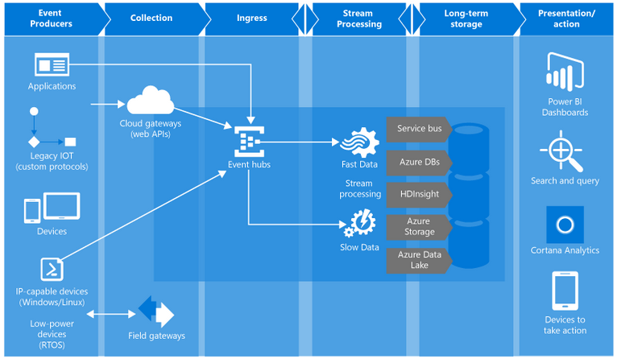
Event Hub
Notes:
Why use Event Hubs? Event Hubs event and telemetry handling capabilities make it especially useful for:
Application instrumentation
User experience or workflow processing
Internet of Things (IoT) scenarios
For example, Event Hubs enables behavior tracking in mobile apps, traffic information from web farms, in-game event capture in console games, or telemetry collected from industrial machines, connected vehicles, or other devices.
Producers send HTTP or AMQP
Consumers can be in groups: to distribute the consumption of events (like partitioning)
In this diagram we see Fast data would go to Stream Analytics while slow data is being routed to an Azure Automation job

Slide 11
An Event Hub is created in the Service Bus Namespace
https://docs.microsoft.com/en-us/azure/event-hubs/event-hubs-what-is-event-hubs

Slide 12
Connectivity for Hybrid Applications
Azure Relay
Hybrid connections and WCF Relay are part of the Azure Relay service
Communicate with on-premises resources without opening a firewall port
Hybrid Connections support multi-platform scenarios.
Hybrid Connections can be used to connect to any TCP port including SQL DB’s and Web API’s.
WCF Relay can communicate with WCF services and .NET Framework only.
VPN
Connect an Azure Web App to on-premises via VPN.
VNET integration gives a multi tenant Web App Access to resources accessible by an Azure VNET.
App Service Environment (ASE) can be deployed into an Azure VNET for bidirectional access.

Slide 13
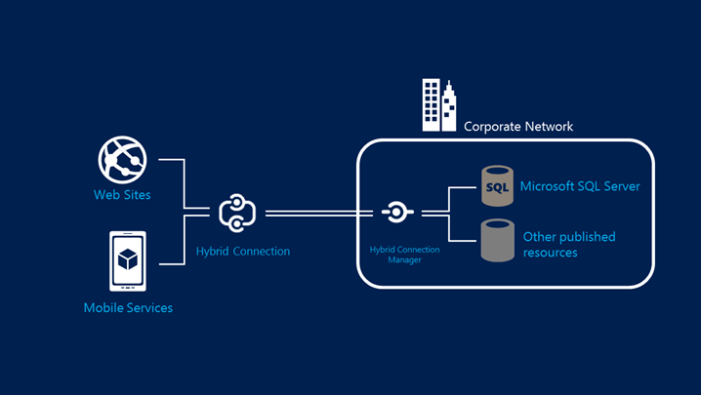
Hybrid Connections Architecture
Notes:
This is conceptually what was leveraged for the CRM System mentioned earlier.

Slide 14
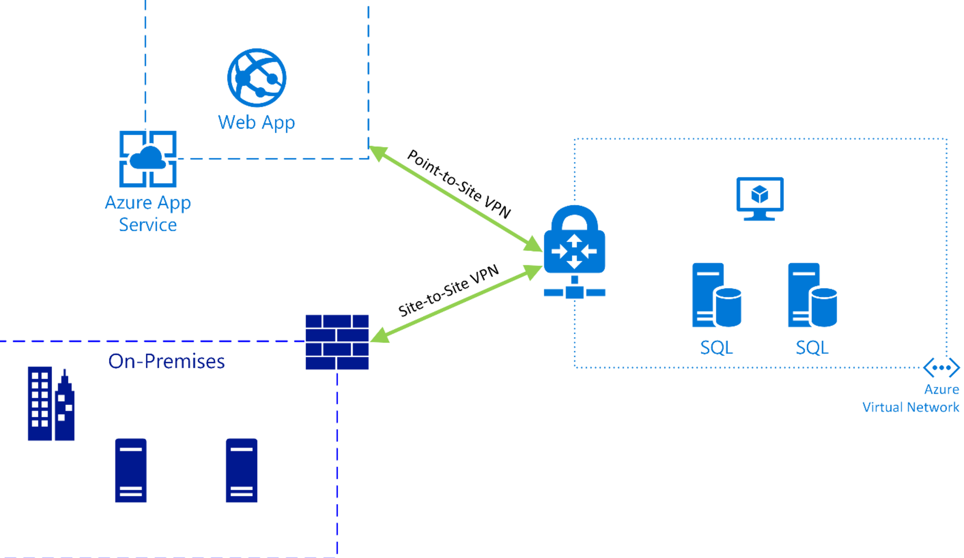
Azure Web App VNET Integration

Slide 15
Question: Your app needs a brokered messaging channel to an on premises line of business application that offers a WCF endpoint to clients. You need to implement connectivity without changing on-premises firewall rules. Implementation needs to have a lower cost compared to other options. Choose an implementation below.
Express Route
Site to Site VPN
Hybrid Connection
WCF Relay
Express Route
Site to Site VPN
Hybrid Connection
WCF Relay

Slide 16
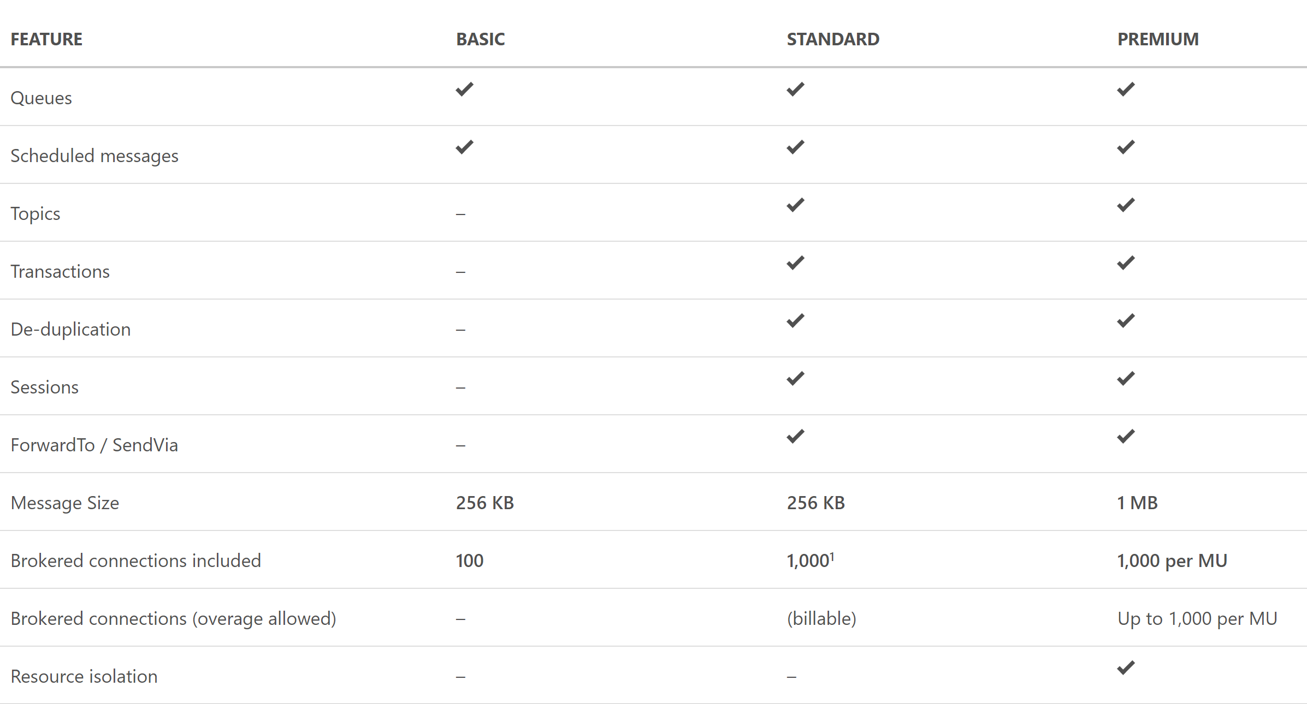
Service Bus Tiers
https://azure.microsoft.com/en-us/pricing/details/service-bus/

Slide 17
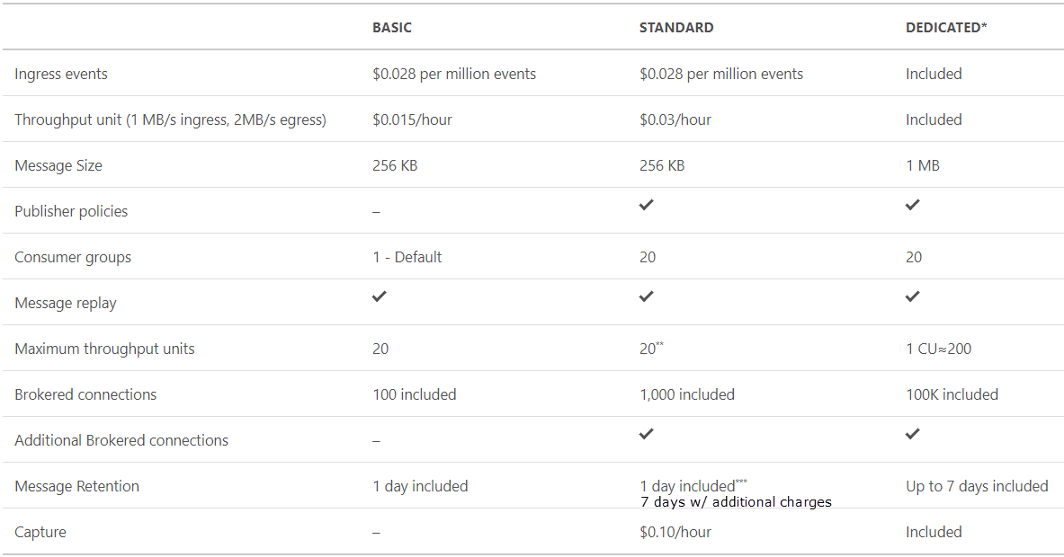
Event Hub Tiers
https://azure.microsoft.com/en-us/pricing/details/event-hubs/

Slide 18
Question: You need to process IOT data from approx 700 devices. Data is fitered and moved into Blob Storage. Archival of raw ingress data is required for a week. Choose an implementation below.
IOT Hub
SQL Database
Event Hub Standard Tier
Event Hub Basic Tier
IOT Hub
SQL Database
Event Hub Standard Tier
Event Hub Basic Tier

Slide 19



Azure Storage Offerings
Blobs
Files
Disks
Tables
Queues
Object storage
Access via REST
File storage
Access via SMB, REST
IaaS VM VHD/ disks
Access via REST
NOSQL storage
Access via REST
Reliable Messaging
Access via REST
Streaming & random object access scenarios
Lift n shift scenarios
Persistent disks for VMs
Premium option
KeyValue Store
Scheduling async tasks
Notes:
Blob storage
Blobs are basically files like those that you store on your computer (or tablet, mobile device, and so on). They can be pictures, Microsoft Excel files, HTML files, virtual hard disks (VHDs), big data such as logs, database backups -- pretty much anything. Blobs are stored in containers, which are similar to folders.
Azure Files
Azure Files enables you to set up highly available network file shares that can be accessed by using the standard Server Message Block (SMB) protocol. That means that multiple VMs can share the same files with both read and write access. You can also read the files using the REST interface or the storage client libraries.
Disk storage
Azure Storage also includes managed and unmanaged disk capabilities used by virtual machines.
Table storage
No SQL Storage for Key/value pairs. Standard Azure Table Storage is now part of Cosmos DB. To see that documentation, see the Azure Table Storage Overview. Also available is Premium Tables for Azure Table storage, offering throughput-optimized tables, global distribution, and automatic secondary indexes.
Queue storage
The Azure Queue service is used to store and retrieve messages. Queue messages can be up to 64 KB in size, and a queue can contain millions of messages. Queues are generally used to store lists of messages to be processed asynchronously.

Slide 20
Implement Background Processing
Azure Web Jobs
Azure Functions

Slide 21

Azure WebJobs
Provides an easy way to run scripts or programs as background processes in the context of an App Service, API App or Mobile App
Scheduled , continuous or triggered
You can upload and run an executable file such as as cmd, bat, exe (.NET), ps1, sh, php, py, js, and jar.
Notes:
WebJobs is a feature of Azure App Service that enables you to run a program or script in the same context as a web app, API app, or mobile app. There is no additional cost to use WebJobs.

Slide 22
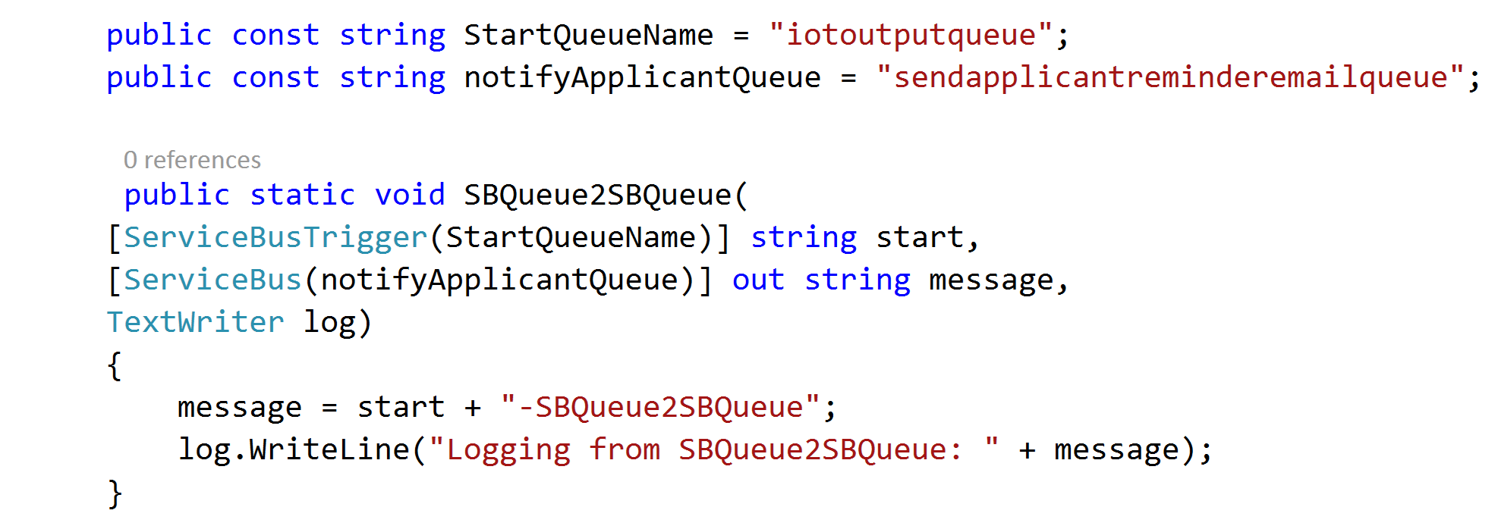
Azure Web Jobs
WebJobs provide an easy way to run scripts or programs as background processes in the context of an App Service, API App or Mobile App
Web jobs can be scheduled , continuous or on-demand
You can upload and run an executable file such as as cmd, bat, exe (.NET), ps1, sh, php, py, js, and jar.

Slide 23
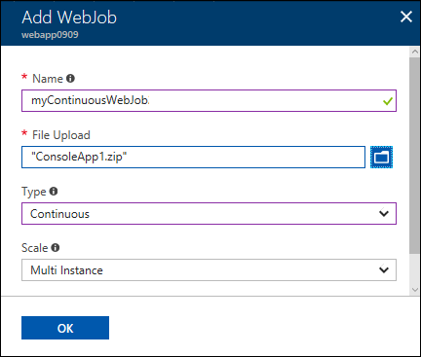
Azure Web Jobs
Upload executable and select type
Scales out with App Service plan
Continuous runs on all instances
Triggered is load balanced across all instances
Notes:
Webjobs can be continuous or triggered or scheduled (schedule trigger).
Resize images into thumbnails
Perform OCR on uploaded documents

Slide 24
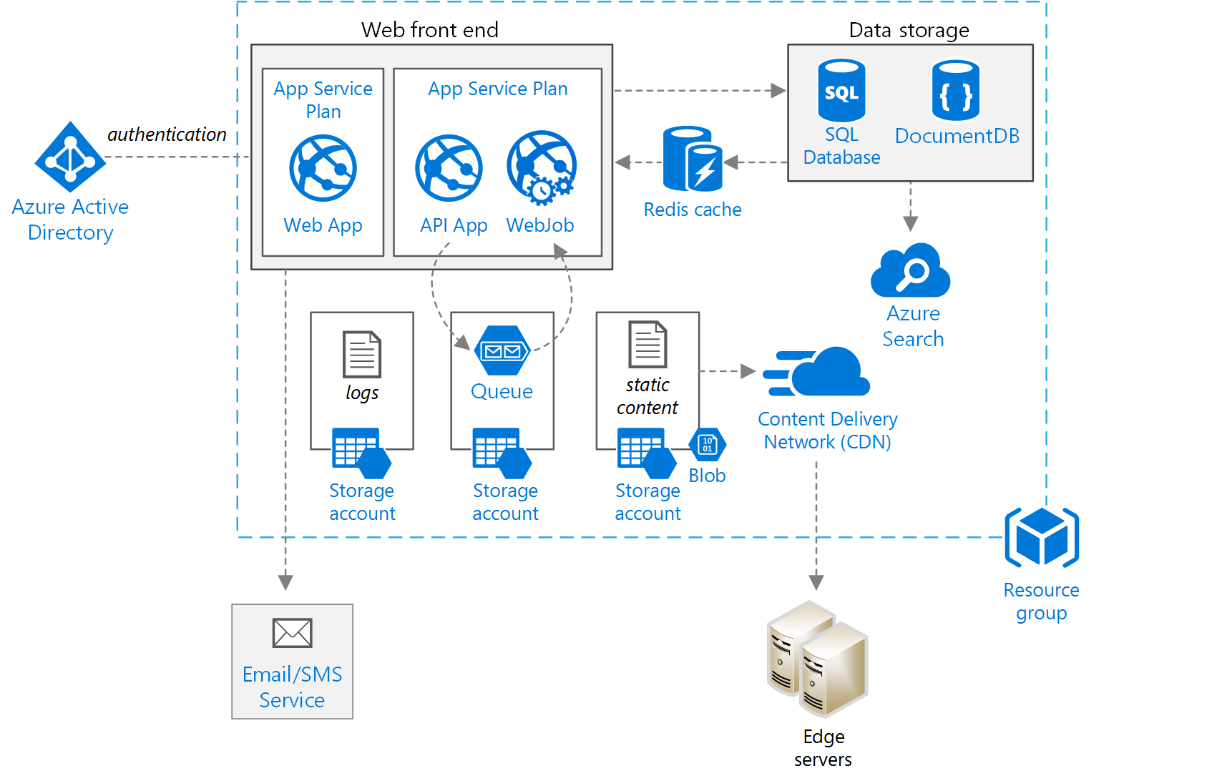
Azure WebJobs
Notes:
You can run WebJobs in an empty App service plan, too….

Slide 25

Azure Functions
True serverless compute
Highly elastic and autoscaling
Can deploy onto an App Service plan
Includes triggers and bindings
Notes:
https://docs.microsoft.com/en-us/azure/azure-functions/functions-overview
Azure Functions is a solution for easily running small pieces of code, or "functions," in the cloud. You can write just the code you need for the problem at hand, without worrying about a whole application or the infrastructure to run it. Functions can make development even more productive, and you can use your development language of choice, such as C#, F#, Node.js, Java, or PHP. Pay only for the time your code runs and trust Azure to scale as needed.

Slide 26
Azure Functions - Triggers
HTTP
Timer
GitHub webhook
Generic webhook
Azure Cosmos DB
Blob storage
Queue storage
Event Hub
Service Bus Queue
Service Bus Topic
Notes:
https://docs.microsoft.com/en-us/azure/azure-functions/functions-overview
Functions provides templates to get you started with key scenarios, including the following:
HTTPTrigger - Trigger the execution of your code by using an HTTP request. For an example, see Create your first function.
TimerTrigger - Execute cleanup or other batch tasks on a predefined schedule. For an example, see Create a function triggered by a timer.
GitHub webhook - Respond to events that occur in your GitHub repositories. For an example, see Create a function triggered by a GitHub webhook.
Generic webhook - Process webhook HTTP requests from any service that supports webhooks. For an example, see Create a function triggered by a generic webhook.
CosmosDBTrigger - Process Azure Cosmos DB documents when they are added or updated in collections in a NoSQL database. For an example, see Create a function triggered by Azure Cosmos DB.
BlobTrigger - Process Azure Storage blobs when they are added to containers. You might use this function for image resizing. For more information, see Blob storage bindings.
QueueTrigger - Respond to messages as they arrive in an Azure Storage queue. For an example, see Create a function triggered by Azure Queue storage.
EventHubTrigger - Respond to events delivered to an Azure Event Hub. Particularly useful in application instrumentation, user experience or workflow processing, and Internet of Things (IoT) scenarios. For more information, see Event Hubs bindings.
ServiceBusQueueTrigger - Connect your code to other Azure services or on-premises services by listening to message queues. For more information, see Service Bus bindings.
ServiceBusTopicTrigger - Connect your code to other Azure services or on-premises services by subscribing to topics. For more information, see Service Bus bindings.

Slide 27
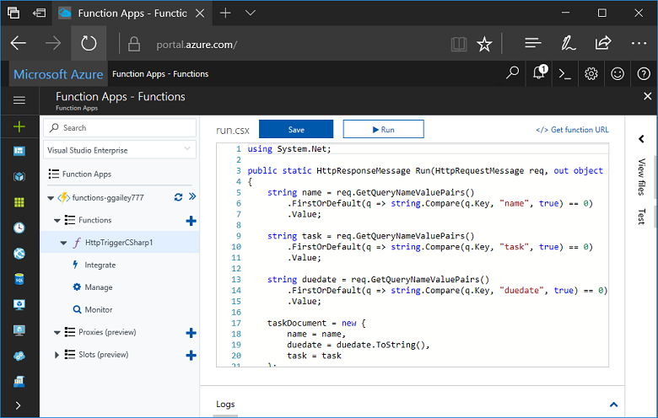
Azure Functions
Notes:
You can edit functions from within the portal.

Slide 28

Logic Apps
Connect to resources and orchestrate workflows
Comprised of triggers and actions
Autoscale, serverless iPaaS
Premium features include EDI, XML validation and B2B trading support
There are many connectors
Notes:
https://docs.microsoft.com/en-us/azure/logic-apps/logic-apps-what-are-logic-apps
Logic Apps provide a way to simplify and implement scalable integrations and workflows in the cloud. It provides a visual designer to model and automate your process as a series of steps known as a workflow. There are many connectors across the cloud and on-premises to quickly integrate across services and protocols. A logic app begins with a trigger (like 'When an account is added to Dynamics CRM') and after firing can begin many combinations of actions, conversions, and condition logic.
The advantages of using Logic Apps include the following:
Saving time by designing complex processes using easy to understand design tools
Implementing patterns and workflows seamlessly, that would otherwise be difficult to implement in code
Getting started quickly from templates
Customizing your logic app with your own custom APIs, code, and actions
Connect and synchronise disparate systems across on-premises and the cloud
Build off of BizTalk server, API Management, Azure Functions, and Azure Service Bus with first-class integration support
Logic Apps is a fully managed iPaaS (integration Platform as a Service) allowing developers not to have to worry about building hosting, scalability, availability and management. Logic Apps will scale up automatically to meet demand.

Slide 29
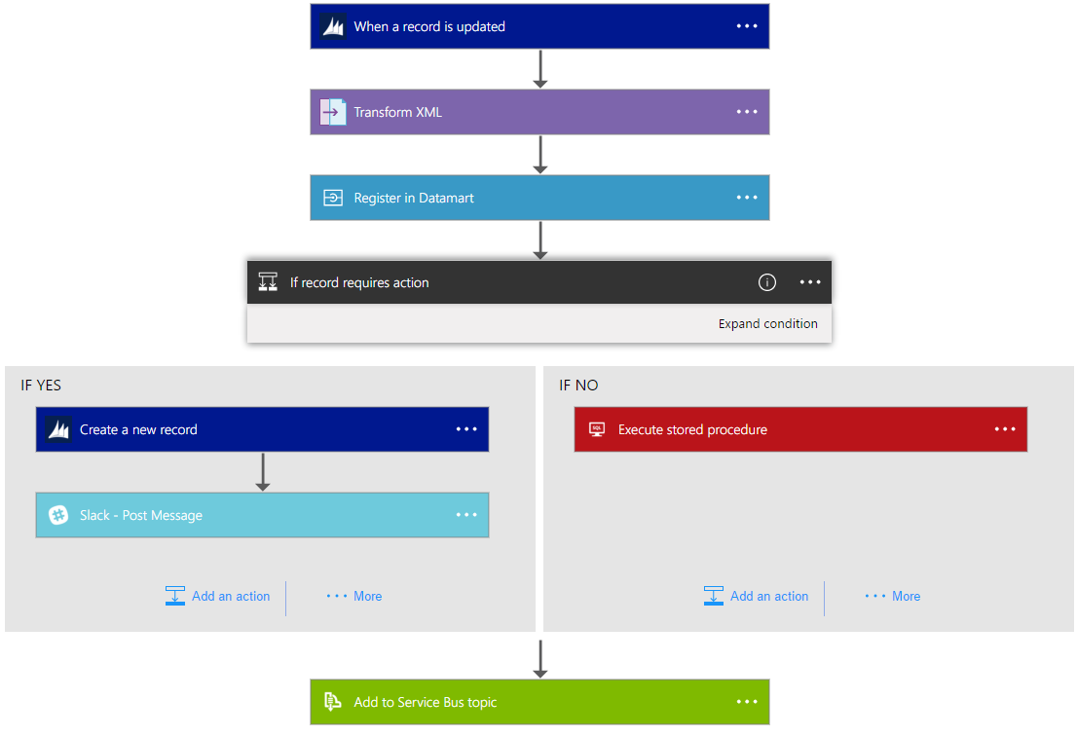
Logic Apps
Notes:
A visual designer is provided, but there is also an SDK for developers to build logic apps into a CI/CD pipeline.
As mentioned, with Logic Apps, you can automate business processes. Here are a couple examples:
Move files uploaded to an FTP server into Azure Storage
Process and route orders across on-premises and cloud systems
Monitor all tweets about a certain topic, analyze the sentiment, and create alerts and tasks for items needing followup.
Scenarios such as these can be configured all from the visual designer and without writing a single line of code.

Slide 30
Question: You are trying to implement a background process to send emails on a scheduled interval. Which Azure function triggers would be suitable?
Event Hub
Blob Storage
HTTP
Timer
Event Hub
Blob Storage
HTTP
Timer

Slide 31
Create Long Running Applications
Azure Scheduler
Azure Batch

Slide 32

Azure Scheduler
Platform service for scheduling reliable actions on a recurrent , simple or complex schedule.
Supports Service bus relay for hybrid scenarios
High availability built in.
Configurable retry policy
Notes:
Azure Scheduler allows you to declaratively describe actions to run in the cloud. It then schedules and runs those actions automatically. Scheduler does this by using the Azure portal, code, REST API, or Azure PowerShell.
Scheduler creates, maintains, and invokes scheduled work. Scheduler does not host any workloads or run any code. It only invokes code hosted elsewhere—in Azure, on-premises, or with another provider. It invokes via HTTP, HTTPS, a storage queue, a service bus queue, or a service bus topic.
Scheduler schedules jobs, keeps a history of job execution results that one can review, and deterministically and reliably schedules workloads to be run. Azure WebJobs and other Azure scheduling capabilities use Scheduler in the background. The Scheduler REST API helps manage the communication for these actions. As such, Scheduler supports complex schedules and advanced recurrence easily.
There are several scenarios that lend themselves to the usage of Scheduler. For example:
Recurring application actions: Periodically gathering data from Twitter into a feed.
Daily maintenance: Daily pruning of logs, performing backups, and other maintenance tasks. For example, an administrator may choose to back up the database at 1:00 A.M. every day for the next nine months.
Scheduler allows you to create, update, delete, view, and manage jobs and job collections programmatically, by using scripts, and in the portal.

Slide 33
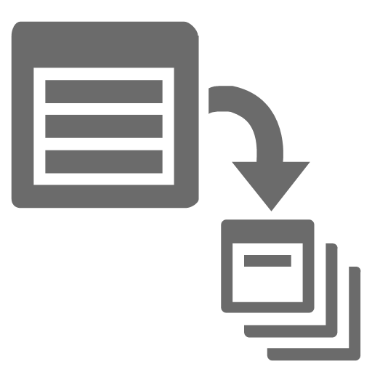
Azure Batch
Batch pools manage Batch jobs
Jobs are comprised of Tasks
Tasks are executable objects (.exe, .ps1, .py, etc.)
Highly scalable
Notes:
Azure Batch is a platform service for running large-scale parallel and high-performance computing (HPC) applications efficiently in the cloud. Azure Batch schedules compute-intensive work to run on a managed collection of virtual machines, and can automatically scale compute resources to meet the needs of your jobs.
With Azure Batch, you can easily define Azure compute resources to execute your applications in parallel, and at scale. There's no need to manually create, configure, and manage an HPC cluster, individual virtual machines, virtual networks, or a complex job and task scheduling infrastructure. Azure Batch automates or simplifies these tasks for you.+
Use cases for Batch
Batch is a managed Azure service that is used for batch processing or batch computing--running a large volume of similar tasks for a desired result. Batch computing is most commonly used by organizations that regularly process, transform, and analyze large volumes of data. A common solution that uses the Batch APIs to interact with the Batch service involves scaling out intrinsically parallel work--such as the rendering of images for 3D scenes--on a pool of compute nodes. This pool of compute nodes can be your "render farm" that provides tens, hundreds, or even thousands of cores to your rendering job,
Batch Pools:
Configure and create VM’s for any scale; less than 10 or more than 10,000.
Both Windows and Linux supported
Low Priority VM’s launched
Batch Jobs and Tasks:
Task is a unit of execution. Anything that can execute from a command line such as EXE, BAT, CMD, PS1 etc.
Run applications unchanged.
Jobs are submitted, Tasks are assigned to VM’s.
Automatic detection and retry of frozen tasks.

Slide 34
Azure Batch — Job Scheduling as a Service
User application or service
Azure Batch
Foundational batch processing service
Avoid building infrastructure
VM management and job scheduling
PaaS
Cloud Services
IaaS
Virtual Machines
Hardware
Notes:
When jobs run, tasks are assigned to VMs. This means programs are copied from storage to the Batch infrastructure and run in parallel. Task management is provided with reporting, and retry of frozen tasks.
The batch pool can either be in the Batch Service subscription, or in user subscriptions (VMs only).
Demo weather map

Slide 35
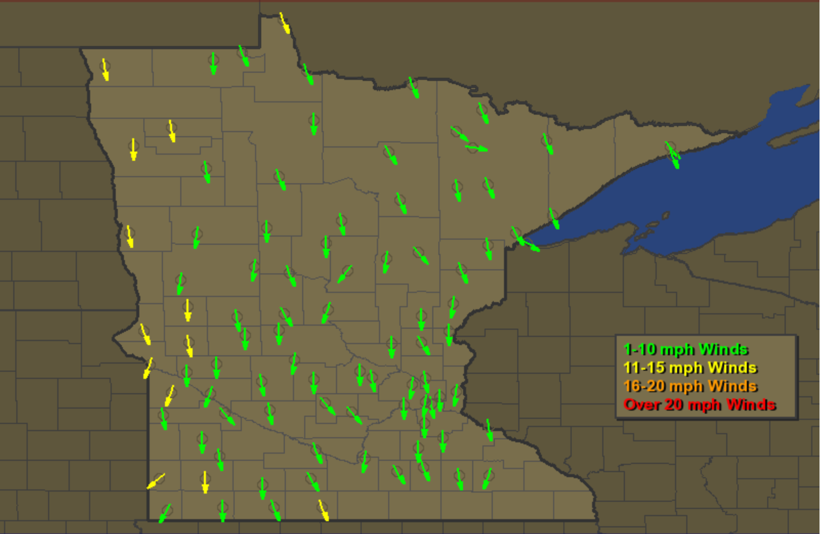
Azure Batch — Job Scheduling as a Service
Notes:
When jobs run, tasks are assigned to VMs. This means programs are copied from storage to the Batch infrastructure and run in parallel. Tasks management is provided with reporting, and retry of frozen tasks.
The batch pool can either be in the Batch Service subscription, or in user subscriptions (VMs only).

Slide 36
Question: Your company needs to run large scale computation workloads. The compute cluster should be able to scale up and down on demand. You are looking for a cost effective option which can be managed by command line scripting. Choose an option below.
Azure Batch
HPC Pack
Web Jobs
Azure Functions
Azure Batch
HPC Pack
Web Jobs
Azure Functions

Slide 37
You do not to create a virtual network or Scheduler before creating an Azure Batch Service.
https://azure.microsoft.com/en-us/services/batch/

Slide 38
Compute-Intensive Applications
High-Performance Computing (HPC)

Slide 39
Big Compute Use Cases
Media transcoding
Rendering
Image analysis & processing
Builds
Test execution
Fluid dynamics
Monte Carlo simulations
Engineering stress analysis
Risk Analysis
Massive parallel computation
AI and Deep learning

Slide 40
High Performance Computing on Azure
HPC clusters in Azure
Access to thousands of cores
RDMA and InfiniBand support in high end VM SKU’s
Micosecond low-latency network
Run MPI applications with close to bare metal performance
Burst to the cloud on demand
On-premises head node and clusters + cloud clusters
Head node in Virtual Machines + cloud clusters
Notes:
Organizations have large-scale computing needs. These Big Compute workloads include engineering design and analysis, financial risk calculations, image rendering, complex modeling, Monte Carlo simulations, and more.
Use the Azure cloud to efficiently run compute-intensive Linux and Windows workloads, from parallel batch jobs to traditional HPC simulations. Run your HPC and batch workloads on Azure infrastructure, with your choice of compute services, grid managers, Marketplace solutions, and vendor-hosted (SaaS) applications. Azure provides flexible solutions to distribute work and scale to thousands of VMs or cores and then scale down when you need fewer resources.+
Solution options
Do-it-yourself solutions
Set up your own cluster environment in Azure virtual machines or virtual machine scale sets.
Lift and shift an on-premises cluster, or deploy a new cluster in Azure for additional capacity.
Use Azure Resource Manager templates to deploy leading workload managers, infrastructure, and applications.
Choose HPC and GPU VM sizes that include specialized hardware and network connections for MPI or GPU workloads.
Add high performance storage for I/O-intensive workloads.
Hybrid solutions
Extend your on-premises solution to offload ("burst") peak workloads to Azure infrastructure
Use cloud compute on-demand with your existing workload manager.
Take advantage of HPC and GPU VM sizes for MPI or GPU workloads.
Big Compute solutions as a service (Marketplace)
Develop custom Big Compute solutions and workflows using Azure Batch and related Azure services.
Run Azure-enabled engineering and simulation solutions from vendors including Altair, Rescale, and Cycle Computing (now joined with Microsoft).

Slide 41
Resources for HPC in Azure
Resources for batch and HPC in the Azure cloud https://docs.microsoft.com/en-us/azure/batch/big-compute-resources
Batch and HPC solutions in the cloud – Azure https://docs.microsoft.com/en-us/azure/batch/batch-hpc-solutions
Linux HPC Pack cluster options in the cloud https://docs.microsoft.com/en-us/azure/virtual-machines/linux/hpcpack-cluster-options
Azure Linux VM sizes - HPC https://docs.microsoft.com/en-us/azure/virtual-machines/linux/sizes-hpc

Slide 42
If your HPC compute cluster requires a management head node and the choices are Azure Batch or HPC Pack then choose HPC Pack.
Azure Batch doesn’t have management head node.
https://docs.microsoft.com/en-us/azure/cloud-services/cloud-services-setup-hybrid-hpcpack-cluster

Slide 43
Integrate Azure Services
Azure Search
Media
Advanced Analytics

Slide 44
Azure Search Overview
A fully-managed search solution that allows developers to enable search experiences in applications.
Embed a sophisticated search experience into web and mobile applications without having to worry about the complexities of full-text search and without having to deploy, maintain or manage any infrastructure.
Perfect for enterprise cloud developers, cloud software vendors, cloud architects who need a fully-managed search solution.
Surface Your Data
Reduce Complexity
Move Quickly with Confidence
Powerful, guaranteed performance
Sophisticated search
Connects business goals to the application
Simplify search index management
Scale-out easily
Fast time to market
Backed by Microsoft Azure
Notes:
Azure Search is a search-as-a-service cloud solution that gives developers APIs and tools for adding a rich search experience over your data in web, mobile, and enterprise applications.+
Functionality is exposed through a simple REST API or .NET SDK that masks the inherent complexity of search technology. In addition to APIs, the Azure portal provides administration and prototyping support.

Slide 45
Azure Search
Use Cases
Ecommerce - Searching for products
News Feed – Newer articles are more relevant
Geospatial search – A Search that is aware of your location.
Unstructured content – Index and search documents
Some Features
Term Boosting – Quiet clean hotel
Synonyms – Motel, Hotel
Notes:
Full text search is a primary use case for most search-based apps. Queries can be formulated using a supported syntax: Simple query syntax, which offers logical operators, phrase search operators, suffix operators, precedence operators. Lucene query syntax offers all of simple query support, plus fuzzy search, proximity search, term boosting, and regular expressions.

Slide 46
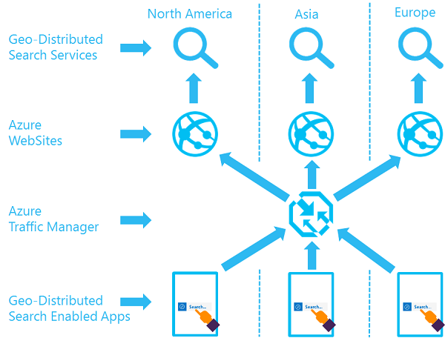
Azure Search
Notes:
Remember that if you protect your web apps with geo-loadbalancing, you should also protect your Search service. The website could be up, but the search service could be down!

Slide 47
What you can do with Media Services
Live and on-demand streaming
Digital marketing platforms
Enterprise video management
Reach hundreds of millions of device endpoints.
Services and tools for video preparation, management and publishing.
Distribute and manage corporate communications, IT, HR content and training.
Notes:
Media Services is an extensible cloud-based platform that enables developers to build scalable media management and delivery applications. Media Services is based on REST APIs that enable you to securely upload, store, encode, and package video or audio content for both on-demand and live streaming delivery to various clients (for example, TV, PC, and mobile devices).
You can build end-to-end workflows using entirely Media Services. You can also choose to use third-party components for some parts of your workflow. For example, encode using a third-party encoder. Then, upload, protect, package, deliver using Media Services.
You can choose to stream your content live or deliver content on-demand.

Slide 48
Media Services Applications
Live event streaming service with CDN capabilities
Studio grade encoding
Content protection and encryption
Distribute content across multiple channels and devices

Slide 49
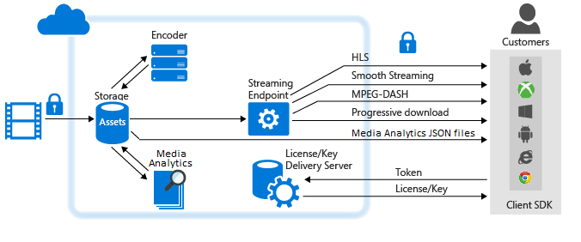
Media Services
Notes:
Here is an example of Protecting content in storage and delivering streaming media in the clear
1. Upload a high-quality media file into an asset. It is recommended to apply storage encryption option to your asset in order to protect your content during upload and while at rest in storage.
2. Encode to a set of adaptive bitrate MP4 files. It is recommended to apply storage encryption option to the output asset in order to protect your content at rest.
3. Configure asset delivery policy (used by dynamic packaging). If your asset is storage encrypted, you must configure asset delivery policy.
4. Publish the asset by creating an OnDemand locator.
5. Stream published content.

Slide 50
Question: Your company uses Azure media services to supply advertising media to partners. Multiple channels are configured within a single instance of Media services. You need to enforce a rule that only content that contains a signed security token can be uploaded. How can we enforce this rule ?
Use a Network Security Group
Create an ingest restriction
Use an Access Control List
Set media services authorization policy to Token
Use a Network Security Group
Create an ingest restriction
Use an Access Control List
Set media services authorization policy to Token

Slide 51



Advanced Analytics
Event production
Collection
Ingestion
Stream Analytics
Storage and
Batch Analysis
Presentation and action
Event Hubs
Event Hubs
Service Bus Queues, Topics
Web/thick client dashboards
Applications
Devices
Stream Analytics
SQL DB, DW
IOT hubs
Legacy IOT (custom protocols)
Search and query
Storage Blobs and Tables
Cloud gateways (web APIs)
Blobs
Document DB
IP-capable devices (Windows/Linux)
Data analytics (Power BI)
Machine
Learning
Azure Data Lake
Low-power devices (RTOS)
Field gateways
Power BI
Devices to take action
Reference Data
more to come…
Notes:
https://docs.microsoft.com/en-us/azure/stream-analytics/stream-analytics-introduction
Use Stream Analytics to examine high volumes of data streaming from devices or processes, extract information from that data stream, identify patterns, trends, and relationships. Use those patterns to trigger other processes or actions, like alerts, automation workflows, feed information to a reporting tool, or store it for later investigation.
Some examples:
Stock-trading analysis and alerts.
Fraud detection, data, and identify protections.
Embedded sensor and actuator analysis.
Web clickstream analytics.
https://docs.microsoft.com/en-us/azure/machine-learning/preview/overview-what-is-azure-ml
Machine Learning is an integrated, end-to-end data science and advanced analytics solution. It enables data scientists to prepare data, develop experiments, and deploy models at cloud scale.
The main components of Azure Machine Learning are:
Azure Machine Learning Workbench
Azure Machine Learning Experimentation Service
Azure Machine Learning Model Management Service
Microsoft Machine Learning Libraries for Apache Spark (MMLSpark Library)
Visual Studio Code Tools for AI
Together, the Machine Learning applications and services help significantly accelerate your data science project development and deployment.
What are the machine learning options from Microsoft?
Besides Azure Machine Learning, there are a wide variety of options in Azure to build, deploy, and manage machine learning models.
Microsoft Machine Learning Services in SQL Server
Microsoft Machine Learning Server
Data Science Virtual Machine
Spark MLLib in HDInsight
Batch AI Training Service
Microsoft Cognitive Toolkit
Microsoft Cognitive Services

Slide 52
Solution Architectures
https://azure.microsoft.com/en-us/solutions/architecture

Slide 53
Labs
https://github.com/dstolts/70-534/tree/master/Labs

